Slide 1
Luxury Housing Sales Analysis – Bengaluru
-By
Silviya X

Slide 2
Problem Statement
The luxury housing market generates large volumes of sales data that can be difficult to analyze manually. This project transforms raw housing sales data into meaningful insights to support strategic decision-making for developers and real estate firms.
Objectives
Clean and preprocess housing sales data.
Load data into a MySQL database.
Build an interactive Power BI dashboard.
Generate business insights from sales trends and buyer preferences.

Slide 3
Technology Stack
Python
Pandas (Data processing)
NumPy
MYSQL
Power BI
Dataset Description
Domain: Real Estate
Location: Bengaluru
Records: 100,000+
Source: GUVI Project Dataset

Slide 4
Key Columns
Property_ID
Developer_Name
Micro_Market
Ticket_Price_Cr
Configuration
Possession_Status
Amenity_Score
Sales_Channel
Buyer_Type
Buyer_Comments
Quarter_Label

Slide 5
Project Workflow
Raw Housing Dataset
↓
Python Data Cleaning
↓
Feature Engineering
↓
Cleaned CSV
↓
MySQL Database
↓
SQL Analysis
↓
Power BI Dashboard
↓
Business Insights

Slide 6
Python & SQL Implementation
Python
Removed missing values
Removed duplicates
Standardized categorical values
Created Quarter_Label and Quarter_Number
Exported cleaned dataset
SQL
Created database and table
Imported cleaned data
Executed validation and aggregation queries
Connected MySQL with Power BI

Slide 7
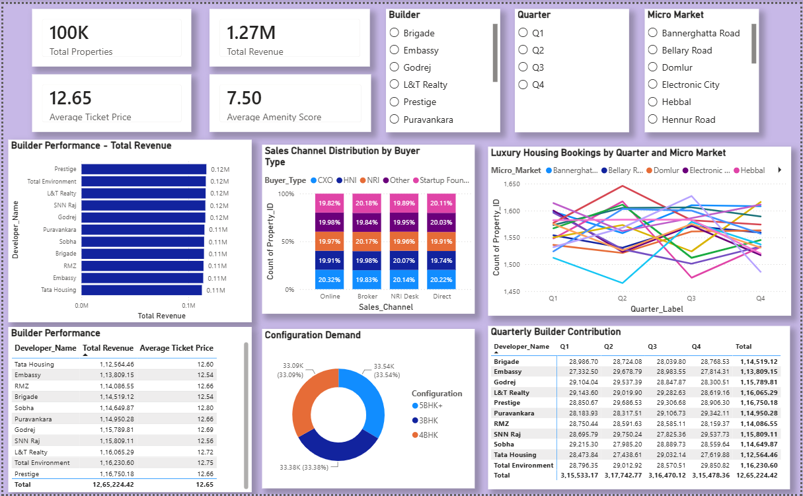
Power BI Dashboard
Dashboard Features
KPI Cards
Market Trends
Builder Performance
Configuration Demand
Sales Channel Analysis
Quarterly Builder Contribution
Interactive Slicers

Slide 8
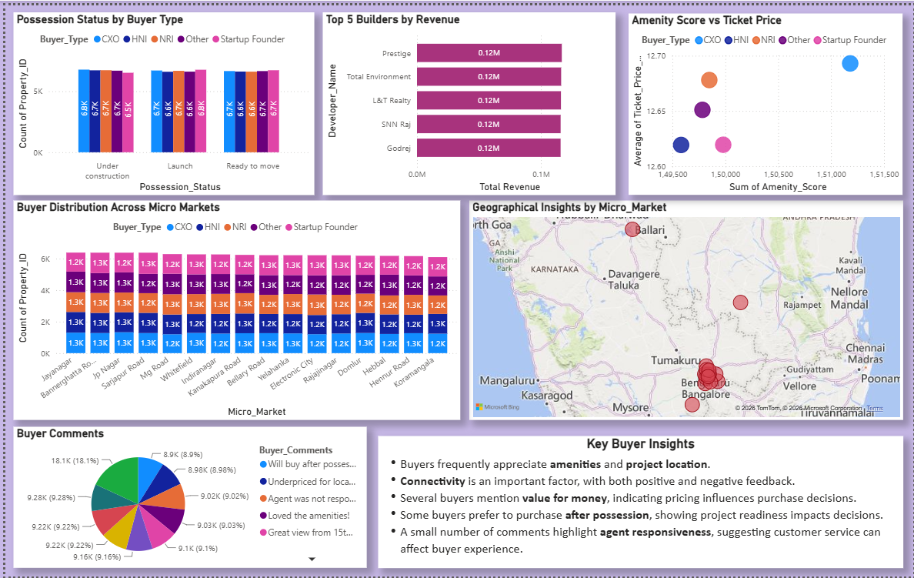
Power BI Dashboard
Dashboard Features
Top Builders
Possession Status Analysis
Amenity Impact
Buyer Distribution
Geographical Insights
Buyer Feedback Analysis

Slide 9
Business Insight
KPI Cards
The total revenue exceeds 1.27 million (dataset units), indicating a high-value luxury housing market.
The average ticket price is 12.65 Cr, reflecting premium residential investments.
The average amenity score of 7.50/10 suggests that most luxury projects provide above-average amenities.
Builder Performance
Revenue is distributed among several leading builders, indicating a competitive luxury housing market.
The average ticket prices across leading builders are relatively close, suggesting similar pricing strategies within the luxury segment.
Sales Channel Distribution
Buyer types are distributed fairly evenly across all sales channels.
No single sales channel dominates a specific buyer segment, indicating that multiple sales channels effectively serve diverse customer groups.

Slide 10
Business Insight
Quarterly Market Trends
Booking activity remains relatively stable across all four quarters.
Different micro-markets experience varying quarterly demand, indicating localized seasonal trends rather than a city-wide pattern.
Configuration Demand
Demand is almost evenly distributed among 3BHK, 4BHK, and 5BHK+ configurations.
Developers should maintain a balanced inventory portfolio.
Quarterly Builder Contribution
Leading builders consistently contribute revenue throughout all quarters.
Revenue contributions remain relatively stable, demonstrating sustained market presence rather than seasonal dependence.

Slide 11
Business Insight
Possession Status Analysis
Buyer distribution remains fairly balanced across projects that are Under Construction, Launch, and Ready to Move.
Customers continue investing in projects at different construction stages, reflecting confidence in reputed developers.
Top Builders by Revenue
Prestige and other leading developers generate the highest overall revenue.
Revenue differences among the top builders are relatively small, indicating healthy competition within the luxury housing market.
Amenity Score vs Ticket Price
Projects with higher amenity scores generally tend to have higher average ticket prices.
Premium amenities appear to contribute positively to perceived property value and pricing.
Buyer Distribution Across Micro Markets
Buyer types are consistently distributed across major Bengaluru micro-markets.
No single buyer category overwhelmingly dominates any specific location, indicating broad demand across customer segments.

Slide 12
Conclusion
Successfully built a complete ETL and analytics pipeline.
Developed an interactive Power BI dashboard connected to MySQL.
Generated actionable business insights for the luxury housing market.
Thank You!

